Slide 1

Using a deployment technology to facilitate a development challenge
2
+
2
+
Dockerized AWS-based backend

Slide 2

The challenge
2
+
A subcontractor for mobile development required access to InShop’s backend
A short-term subcontractor (2-3 months contract) was required to access InShop’s backend. Establishing a secured access for such as short duration seemed like an overkill.
QA and Product access to the backend could become more complicated than the web-app. Setting up a mobile emulator for each stakeholder could become complicated (networking/cyber ..).
InShop’s version (2.x or 3.x) was not yet decided.

Slide 3

The solution
33
2
+
Isolated backend in AWS

Slide 4


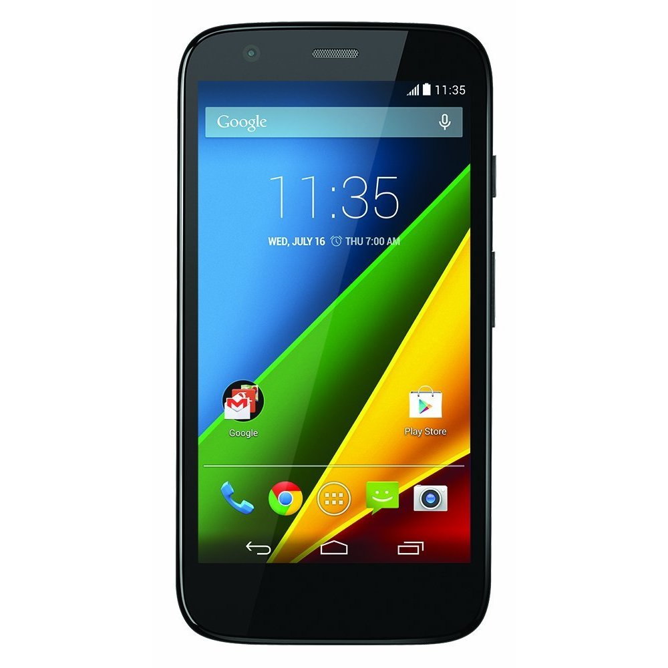
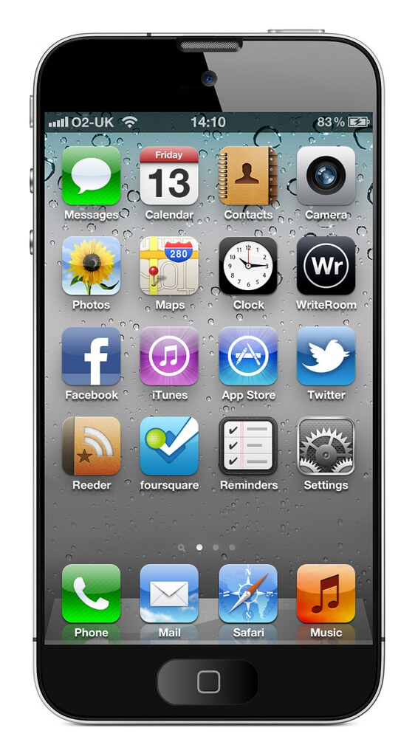




MMA : Management Mobile App
Sprint review 21.17 (+21.16)
Project status : On hold (scope undergoing changes)
Cloud-based InShop MMA
Kafka
3rd party Push Notification server
Push-Notifications (topic)
REDIS
Push notification tokens
REST call
Push notification
On-premise InShop
Postgres
Push notification tokens
Push notification tokens
Postgres
Push Notifications (microservice)
(Alerts data : Trend Graph + 3 lowest Affected Lots)
Serving Layer
Serving Layer
Alert data: Trend Graph + 3 lowest Affected Lots (HTTPS POST request)
Alternatives:
Cloud account per customer.
Frontline cloud account, SaaS model.

Slide 5

advantages
Disadvantages
The subcontractor, Product and QA could access the backend from their own cell phones, without setup.
The architecture could be extended to a full-fledged cloud-based offering, either in a private environment per customer (e.g. private AWS account per customer), or as a SaaS offering.
Required copying of tables between the on-prem InShop.
Requires its own build pipeline.

Slide 6
THANK YOU
2
+
2
+

